Slide 1
Real Estate Affordability based on Price to Income and Venue Data Analysis of London, UK
Elnaz Limouchi
April 2020

Slide 2
Introduction
choose the regions where real estate are more affordable
select the area according to the social places density
creating a map of London and inserting the information on that
clustering each area based on the density of venue

Slide 3
Data Description
Ratio of House Prices to Earnings (full-time workers by place of work) of London
Forsquare API to get the most common venues of given Borough of London

Slide 4
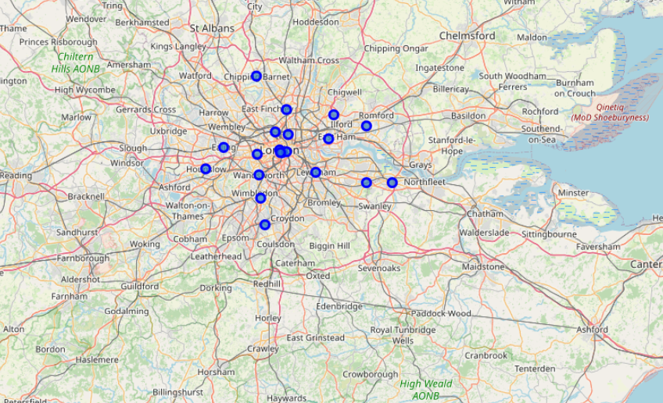
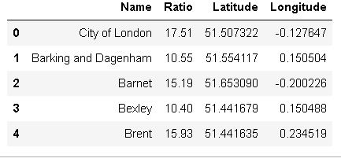
Methodolgy

Slide 5
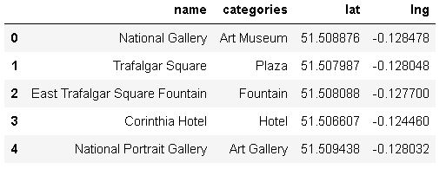
List of venues of London by Foursquare

Slide 6
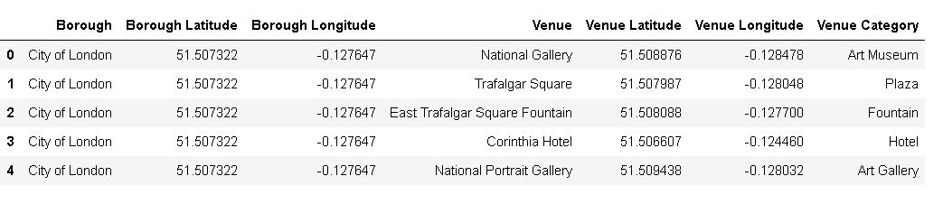
Merged table of boroughs and venues

Slide 7
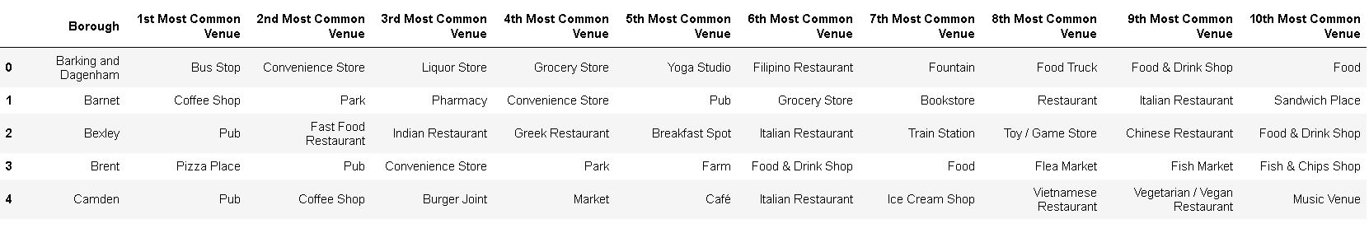
List of top 10 venue category for each borough

Slide 8
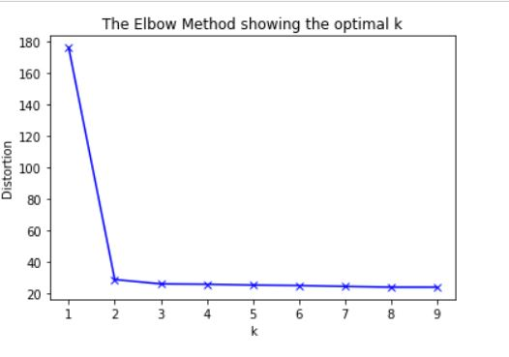
K-Mean Algorithm

Slide 9
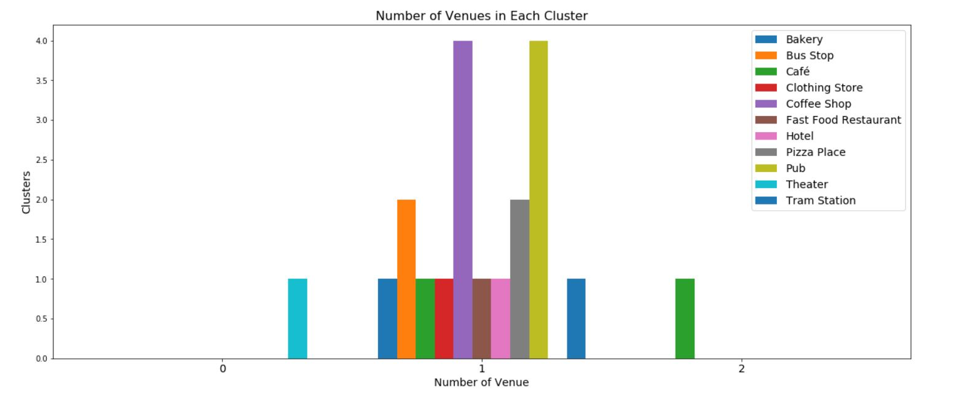
Number of Venues in Each Cluster

Slide 10
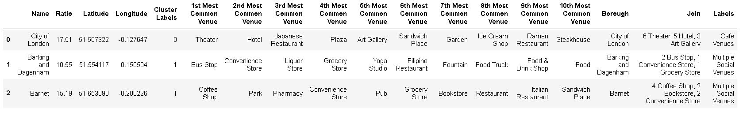
Result

Slide 11
Discussion
Using Kmeans algorithm as part of this clustering study. Based on the Elbow method, the optimum k value is set to 2. However, only 20 district coordinates were used.
Also, data analysis was done through this information by adding the coordinates of districts and affordability as static data on GitHub.
This work finalized by visualizing the data and clustering information on the London map.
As a result, people can achieve better outcomes through their access to the platforms where such information is provided in order to make a decision regarding business start/development.

